Slide 1



SMART SEP
AI & IoT-Powered Advanced Biodegradable and Non-Biodegradable Waste Segregation and Monitoring System
Inventors: Anubhab Kundu Sumit Pal Arijita Paria
Supriyo Paramanik
1

Slide 2
Objective & Extended Abstract (Problem Definition)
The Global Challenge: Over 2 billion tons of municipal waste is generated annually, with a projected 70% increase by 2050.
The Gap: Many cities collect only 50–80% of waste despite spending up to 95% of budgets on collection. Manual sorting is labor-intensive, hazardous, and leads to high contamination in recycling streams.
Our Objective: To provide a comprehensive IoT-enabled system that automates outdoor monitoring, real-time classification, and robotic collection to reduce manual labor and environmental harm
Societal/Market Relevance: Prevents methane-related hazards and health risks from open dumps while optimizing municipal resources.
Uniqueness: Unlike existing stationary or indoor "smart bins," this system fuses multiple sensing modalities—vision, gas, location, and fill levels—with an autonomous robotic collection vehicle
2

Slide 3
THEORETICAL BACKGROUND
Mathematical & Simulation Basics
Ultrasonic Sensor ( HC-SR04) Distance = (Time × 343) / 2
Fill Level = Bin Height - Distance Range: 0 cm – 25 cm
DC Motor (Car Movement) Forward: M1 = 1, M2 = 0
Backward: M1 = 0, M2 = 1
Speed ∝ PWM Duty Cycle
Servo Motor ( Robotic Arm) 0° ≤ θ ≤ 180°
Angle = ((Pulse Width - 1ms) / 1ms) × 180°
Basic Principle
AI-Enhanced Edg e Computing :
Processes
visual data locally on an ESP32-CAM module
using OpenCV to classify waste without cloud latency.
Multi-Sensor Fusion: Combines time-of-
flight ultrasonic data, electrochemical gas sensing, and thermohydrometric data for holistic bin status.
4) GPS ( NEO-6M)
d = 2r sin■¹( √[ sin²(∆φ/2) + cosφ1 cosφ2 sin²(∆λ/2) ] )
Robotic Automation: Employs 4-DOF
(Degrees adaptive
segregation
of Freedom) kinematics waste handling and
for metal
5) MQ -4 Gas Sensor
ppm = Sensor Output / Calibration Factor Alert: CH4 > 2 ppm
6) DHT11 Sensor
20°C ≤ T ≤ 35°C
30% ≤ H ≤ 70%

Slide 4
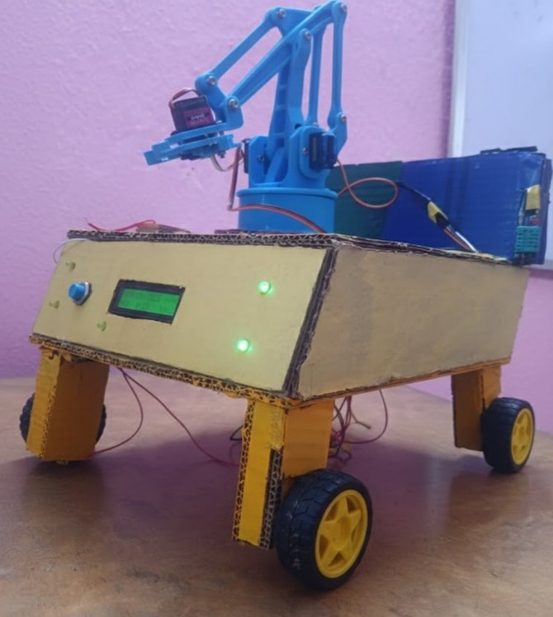

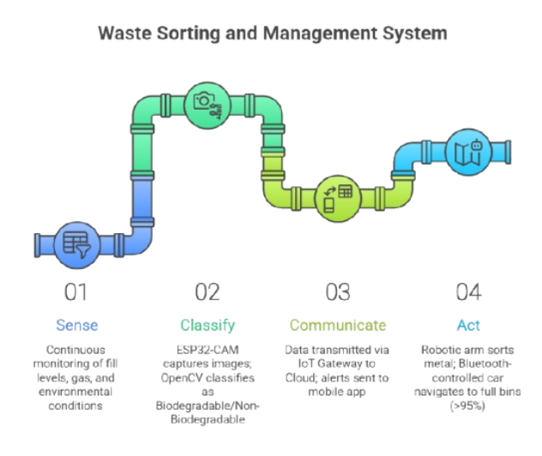
FLOWCHART
Our Present Productt
Process Flow Flowchart Overview:
Sense: Continuous monitoring of fill levels, gas, and environmental conditions.
SCAN ME
Classify: ESP32-CAM captures images; OpenCV classifies as Biodegradable/Non-Biodegradable.
Communicate: Data transmitted via IoT Gateway to Cloud; alerts sent to mobile app.
CClliicckk MMee:: hhttttppss::////aapppp..eerraasseerr..iioo//wwoorrkkssppaaccee//iimm77 QQtteeWWkkVVCC99IISSssRRssGGkkII88??oorriiggiinn==sshhaarree
Act: Robotic arm sorts metal; Bluetooth- controlled car navigates to full bins (>95%).
4

Slide 5
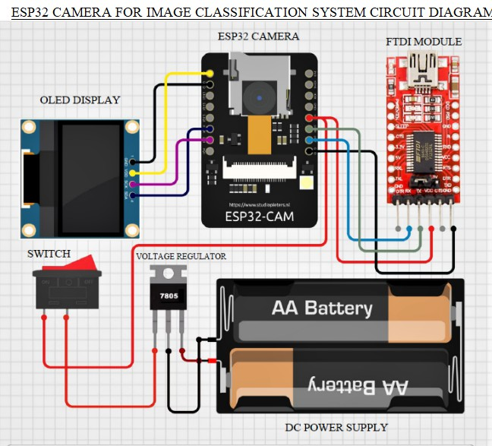
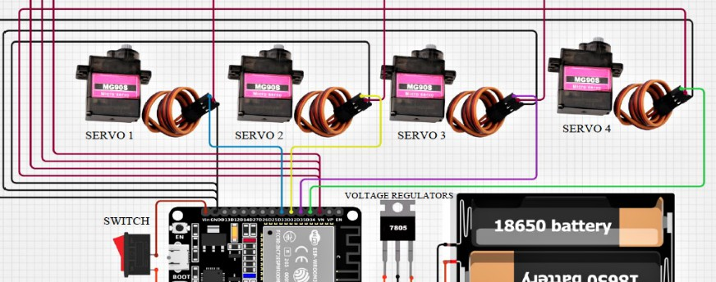
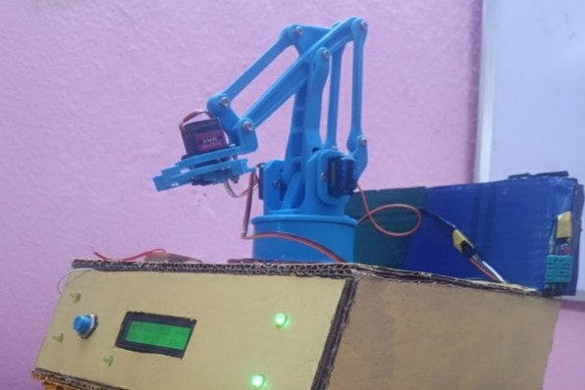
IMPLEMENTATION (HARDWARE PROTOTYPE)
SENSOR NODES: HC-SR04 (DISTANCE), MQ-4 (METHANE), DHT11 (TEMP/HUMIDITY), METAL DETECTOR.
CORE CONTROLLER: ESP32-CAM FOR AI PROCESSING AND WI- FI CONNECTIVITY.
MOBILE UNIT: BLUETOOTH-CONTROLLED CAR WITH NEO-6M GPS FOR LIVE TRACKING AND A 4-DOF ROBOTIC ARM.
POWER: INTEGRATED SOLAR-POWERED BATTERY SYSTEM FOR OFF-GRID OPERATION.
5

Slide 6
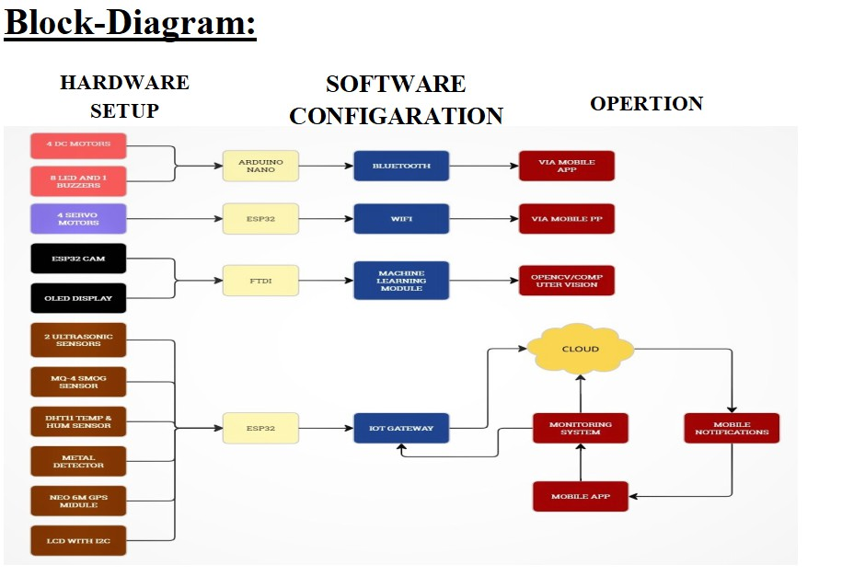
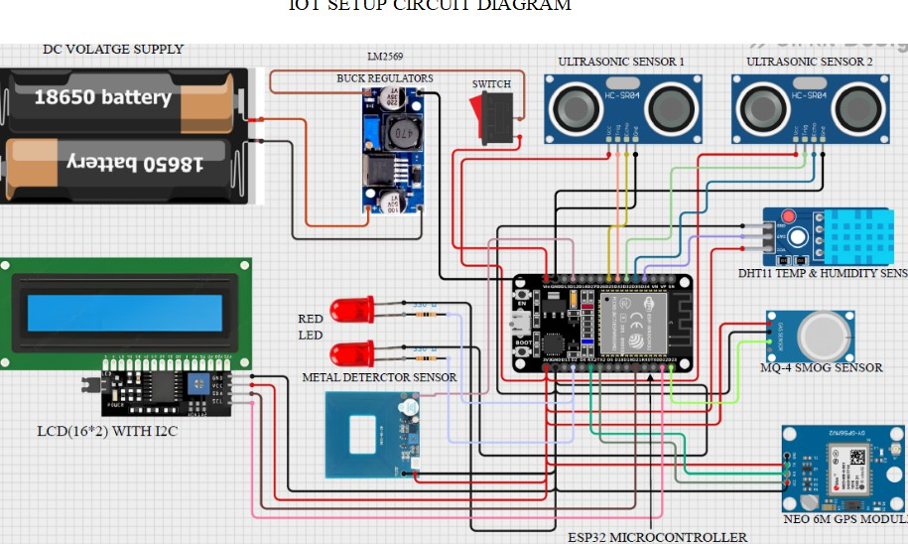
IMPLEMENTATION (SOFTWARE & CLOUD INTEGRATION)
Edge AI: OpenCV Python model optimized for low-computational overhead on microcontrollers.
IoT Gateway: Central hub for data collection, supporting multiple wireless protocols (Wi-Fi, GPS).
Cloud Platform: Aggregates time-stamped data for audit trails and route optimization.
Mobile App: Provides real-time visualization of GPS locations, bin status, and manual override controls.
6

Slide 7
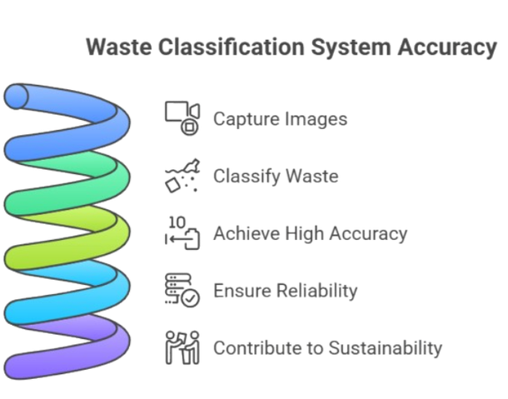
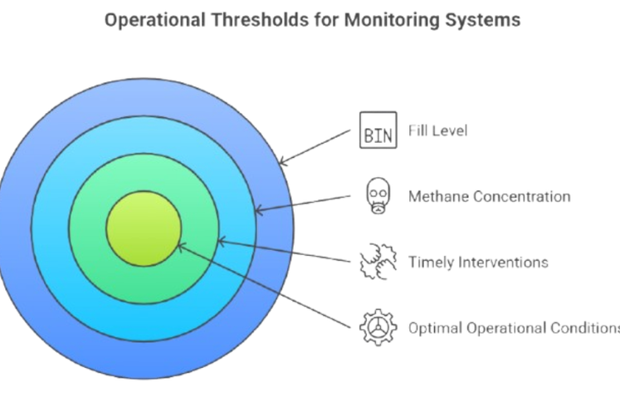
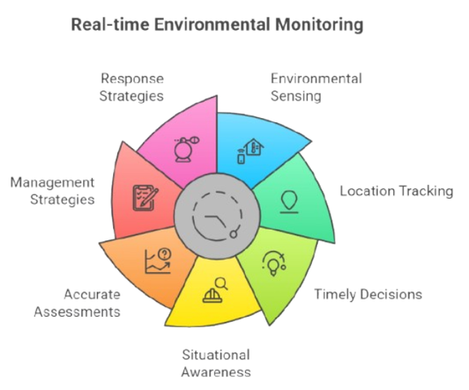
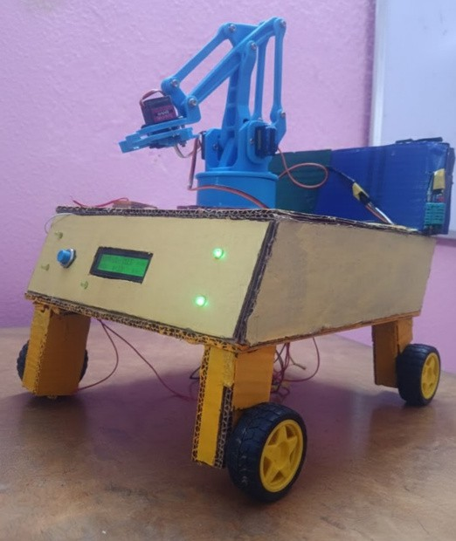
IMPLEMENTATION (EXPERIMENTAL RESULTS)
Classif ication Accuracy : Achieved 98% accuracy in distinguishing waste types under varying lighting.
Operational Thresholds: Reliable alerts triggered at 95% fill level and >1500 ppm Methane.
Responsiveness: Minute-by-minute updates for environmental sensing and location tracking.

Slide 8
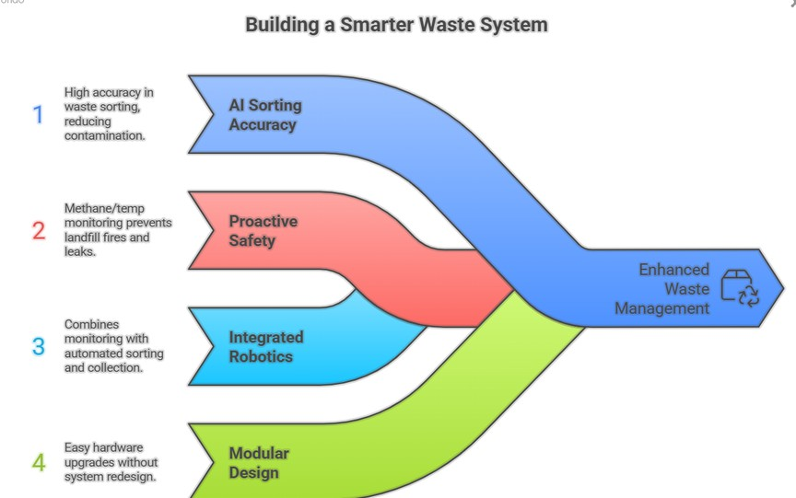
SOLUTION & UNIQUENESS
98% AI Sorting Accuracy :Dramatically reduces recycling compared to manual methods.
contamination
Proactive Safety: First-of-its-kind methane/temp monitoring to prevent landfill fires and hazardous gas leaks.
Integ rated Robotics: Combines monitoring with an automated 4-DOF sorting arm and GPS-guided collection vehicle.
Modular Desig n: Allows hardware upgrades (new sensors or AI models) without system redesign.

Slide 9
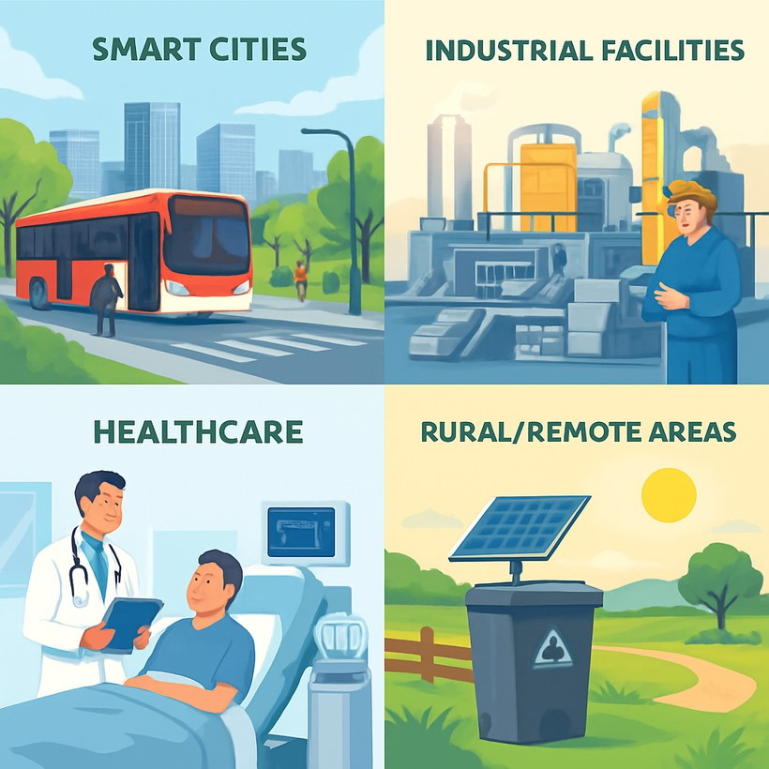
MARKET FEASIBILITY & APPLICATIONS
Smart Cities: High-traffic urban zones like transit hubs and parks.
Industrial Facilities: Factories and campuses requiring safe handling of hazardous or metallic materials.
Healthcare: Adapting sensors
for
biomedical waste monitoring in hospitals.
Rural/ Remote Areas: Off-grid, solar- powered bins for communities with limited electrification.

Slide 10


